Slide 1

SOFTWARE ENGINEERING
TOLGA BOROĞLU

Slide 2



TOPIC :
USE CASE SCENARIO AND DIAGRAM

Slide 3

USE CASE SCENARIO AND DIAGRAM

Slide 4
Associations and multiplicity
DOCTOR
HASTA
ADMIN
HASTA
HASTA
RANDEVU
ADMIN
RANDEVU

Slide 5
Use Case Scenario
Use case Name : Hospital Patient Registration
Actors : Admin,Doctors,Patient
Goals : Add, delete and show patient, doctor, admin .Also add,show,delete a patient appointment.
Preconditions : Admin uses and controls the system, and thanks to this system, it provides the connection between the patient, the doctor and the admin.

Slide 6
USE CASE STEPS :
Actor: Admin
Step 1 : Sign in admin or Log in Admin
Step 2 : Admin add,show and delete Admin and Doctors.
Step 3 : admin add patient registration appointment

Slide 7
USE CASE STEPS cont:
Actor : Doctor
Step 1 : Doctor show patients and appointments
Actor : Patients
Step 1 : Show available appointment times
Step 2 : make an appointment
Step 3 : choose doctor and clinic

Slide 8
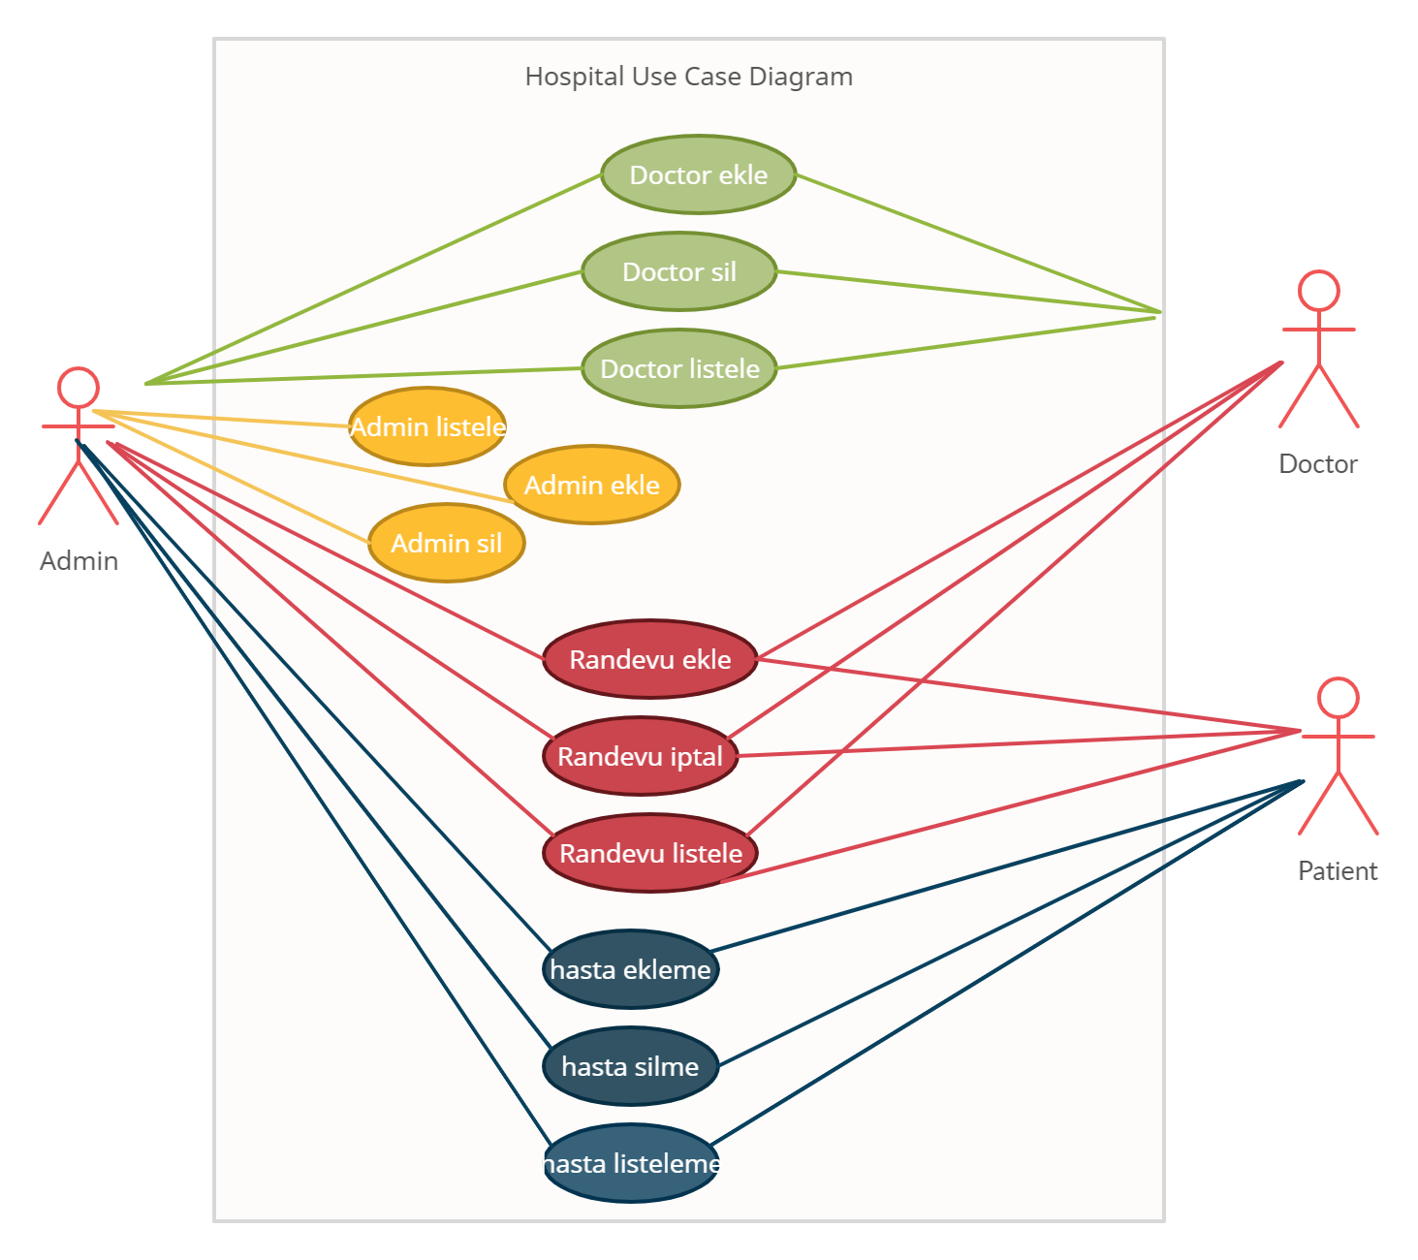

Slide 9


THANK YOU☺
TOLGA BOROĞLU
tolgaboroglu@gmail.com
https://www.teknovblog.com/

Slide 10

Başlamanın en iyi yolu konuşmayı bırakıp harekete geçmektir.
Walt Disney

